Slide 1



Bicubic Low Resolution
GANs Output
High Resolution Ground Truth

Slide 2
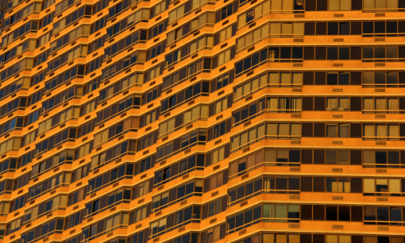

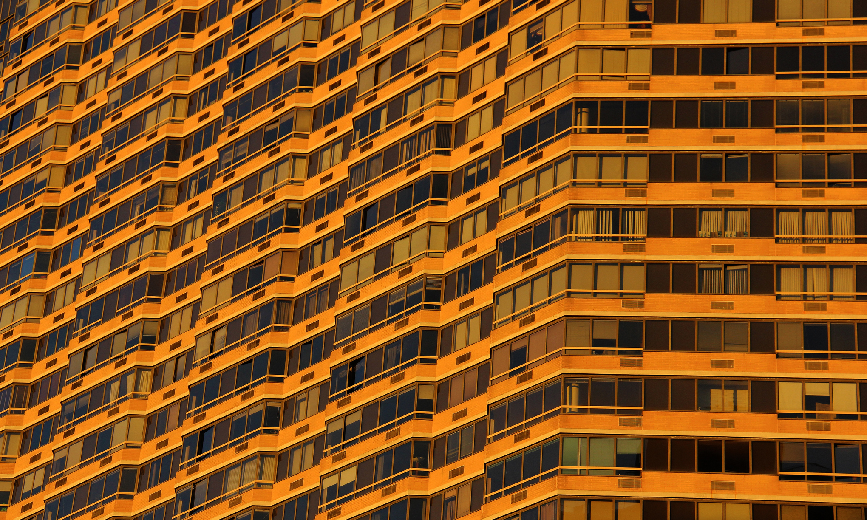
Bicubic Low Resolution
GANs Output
High Resolution Ground Truth

Slide 3
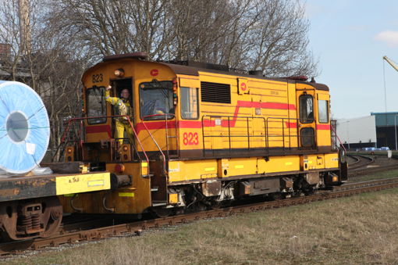

Bicubic Low Resolution
GANs Output
High Resolution Ground Truth

Slide 4
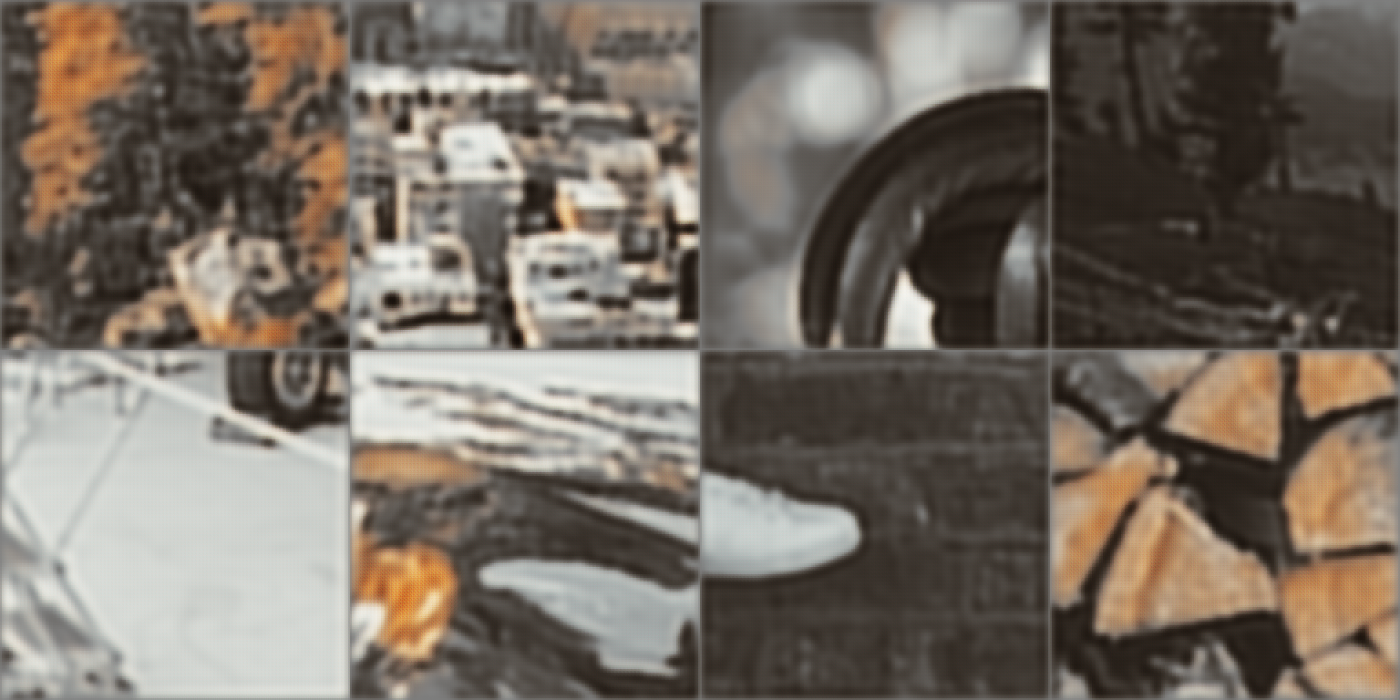
Generator Epoch 10

Slide 5
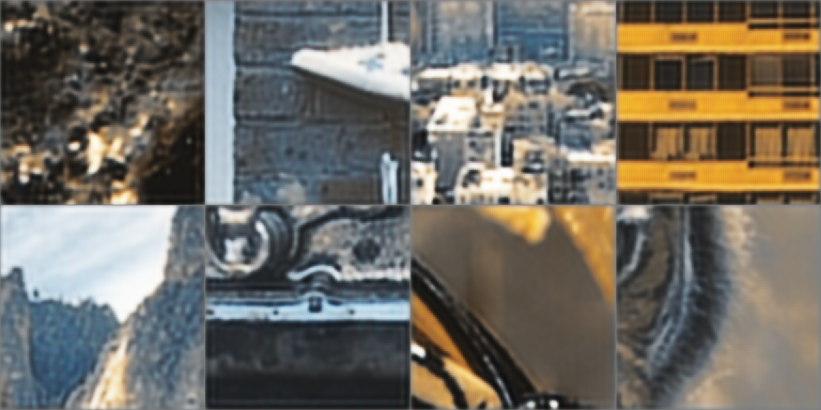
Generator Epoch 20

Slide 6

Generator Epoch 40

